Slide 1
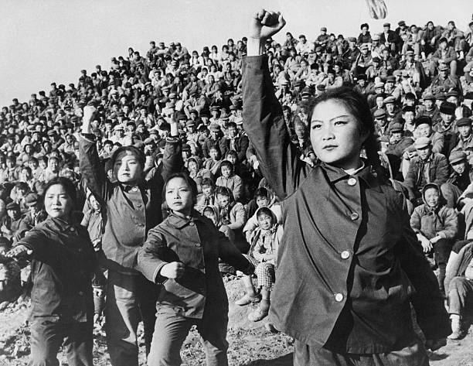
Module 1
Origins of the Cultural Revolution

Slide 2
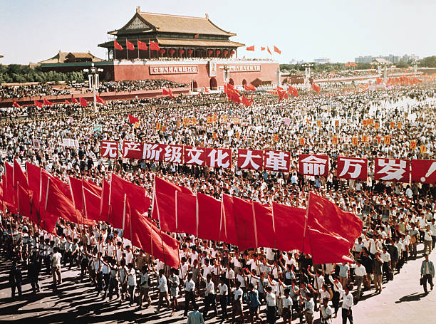
Major Questions:
What was the Cultural Revolution?
Who was responsible for the Cultural Revolution?
What were the origins of the Cultural Revolution?
What were the long-term consequences of the Cultural Revolution?

Slide 3
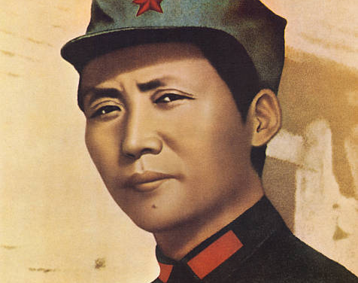
Module 1 Question:
Was Mao Zedong a dictator?
A form of government in which absolute power is concentrated in a dictator or a small clique.
How were events in the Soviet Union connected to the Cultural Revolution?

Slide 4
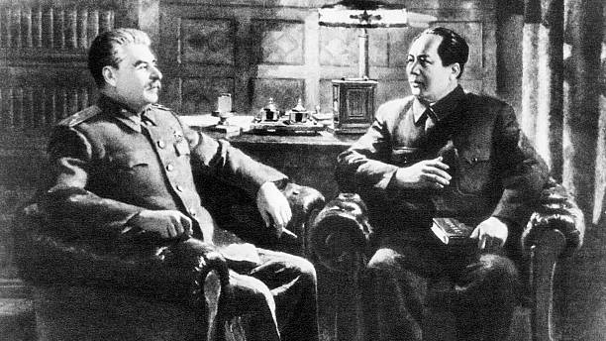
Module Theme:
Competing Visions for China

Slide 5
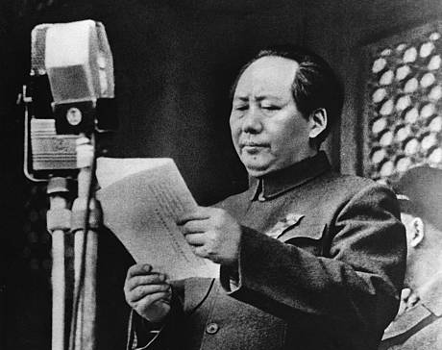
Setting the Stage for the Cultural Revolution
October 1, 1949, Mao Zedong proclaims the establishment of the People’s Republic of China.
“New China” would “Lean to one side.”
Siding in the Soviet Union.
Following the Soviet Model by creating a highly bureaucratic state.

Slide 6
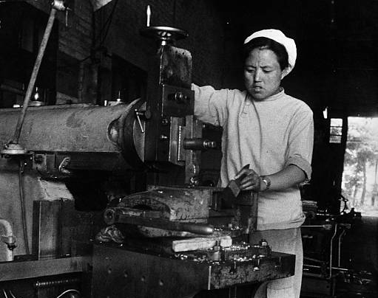
The First Five Year Plan (1953-1957)
Soviet Planned Economy
Heavy industry as a prerequisite for further growth.
Emphasized Heavy Industry
88% percent of budget dedicated to heavy industries: Steel, Machine Building, Fuel, Electric Power, Metallurgy, and Basic Chemicals.
Only 11% of investment to go to light industries.
Economic Growth at 14.7%.
Fostered rapid urbanization.
Notes:
Based on Soviet Union First Five Year Plan. The assumption was that a strong base of heavy industry was needed before any country could develop consumer industries.

Slide 7
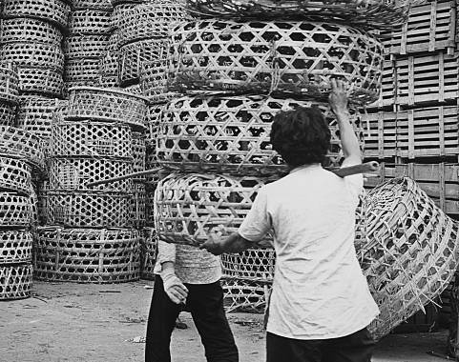
The First Five-Year Plan Continued
New & Growing Modes of Inequity
Urban vs. Rural Divide
Stagnating Agricultural Production
Agricultural Growth 2.7%
Population Growth 2.2%
Growth of Education Opportunities
Increase from 26,000,000 to 64,000,000 formal students
University Enrollment from 117,000 to 441,000.
Notes:
New Modes of Political Expertise

Slide 8
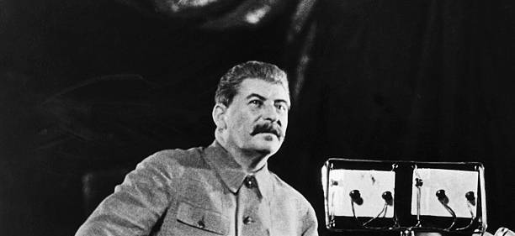
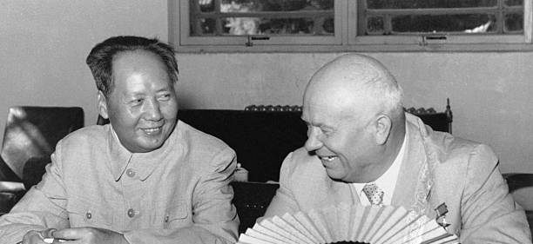
Nikita Khrushchev's Secret Speech
Joseph Stalin (1878-1953)
Leader of the Soviet Union 1922-1952
Defeated Hitler & Boosted the Soviet Union’s economy
A ruthless dictator
Responsible for the deaths of millions
February 25th, 1956
Khrushchev denounces Stalin for his “Cult of Personality”

Slide 9
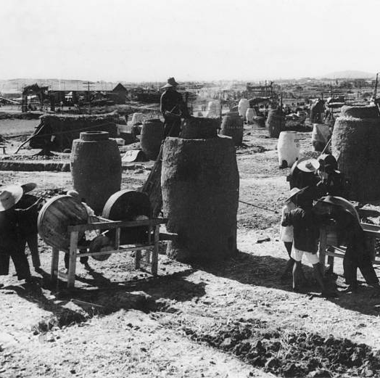
Mao’s Criticism & The Great Leap Forward
Mao’s criticism
“Red vs. Expert”
Red = Marxist/Maoist Revolutionary
Expert = Possessing expertise.
Older revolutionaries replaced by industrial experts.
The Great Leap Forward (1958-1962):
Mao’s attempt for China to leap from socialism to communism.
Stages of development: Feudalism, Capitalism, Socialism, Communism.
“Socialist Ends by Socialist Means”
Mao planned to use the leap to surpass Britain in industrial production in under 15 years.
Industrialization of the countryside.

Slide 10
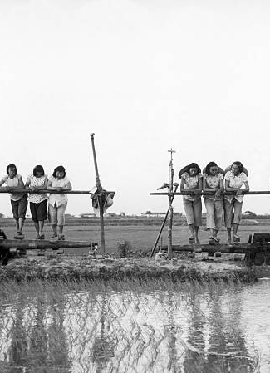
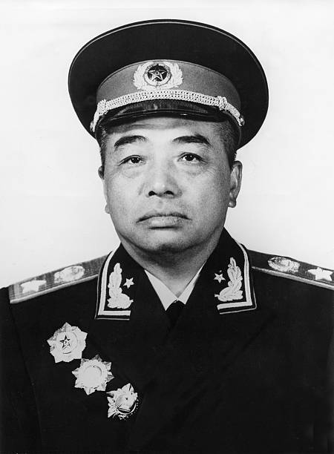
The Lushan Plenum (1959)
Peng Dehuai
Long time communist general and leader of Chinese forces during the Korean War (1950-1953).
Penned a letter critical of Mao’s Great Leap Forward. In it, he warned of a growing catastrophy.

Slide 11
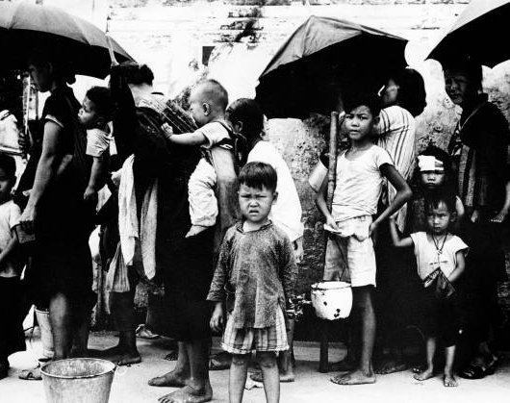
The Results of the Great Leap Forward (1960-1962)
Natural Disasters
Severe Flooding
The Sino-Soviet Split
China and the Soviet Union dispute over ideology
The Soviet Union recalls its 1,400 scientist and industrial specialist
Agricultural woes
Grain output 1958 (200,000,000 tons) vs. Grain output 1960 (144,000,000 tons)
Crushing Famine
15,000,000 to 30,000,000 Famine related deaths between 1959-1961

Slide 12
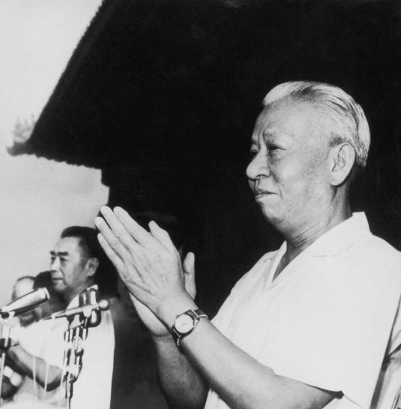
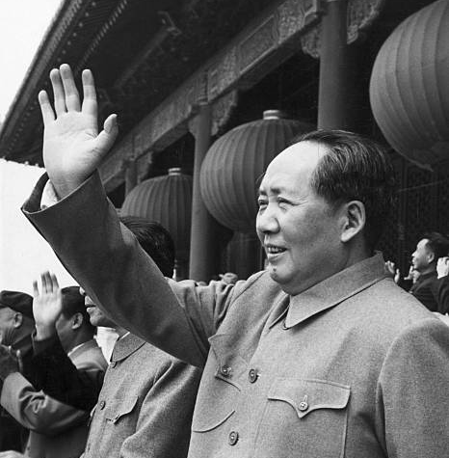
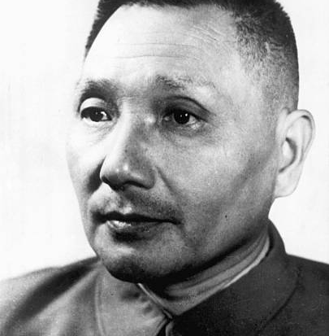
Mao Sidelined
Between 1960-1965, Mao complained he was treated like a “dead ancestor.”
Mao was Chairman of the CCP but could not set party policy.
Liu Shaoqi & Deng Xiaoping (among others) guided the party.

Slide 13
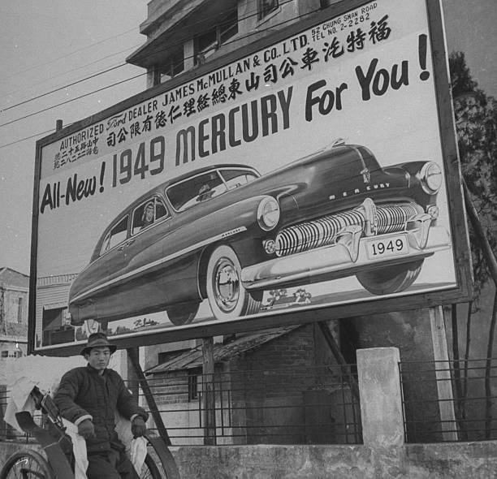
Competing Views of “New” China.
Mao’s Revolutionary Model vs. the Soviet Model
Mao believed that the revolutionary spirit could overcome China’s poverty.
Liu Shaoqi wanted to build up China government and heavy industries to guide China into the future.
Question Review
Was Mao Zedong a dictator?
a form of government in which absolute power is concentrated in a dictator or a small clique.
How were events in the Soviet Union connected to the Cultural Revolution?

Slide 14
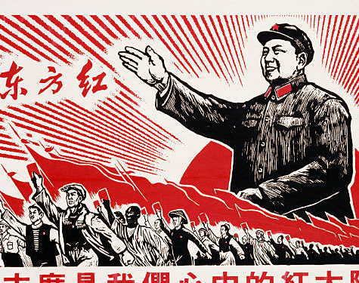
Module 2
The Cultural Revolution (1966-1972)

Slide 15
Major Questions:
What was the Cultural Revolution?
Who was responsible for the Cultural Revolution?
What were the origins of the Cultural Revolution?
What were the long-term consequences of the Cultural Revolution?

Slide 16
Module 1 Question:
When did the Cultural Revolution begin, who launched it, and Why?
Why did so many Chinese citizens go along with the Cultural Revolution?

Slide 17
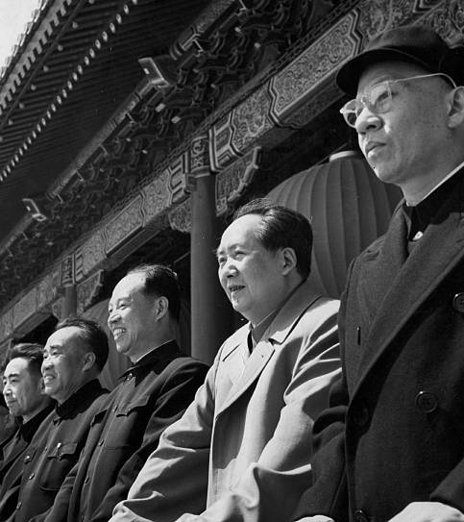
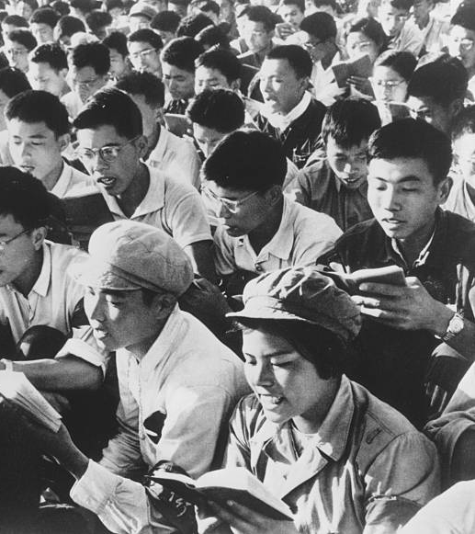
Module Theme:
Political Rivalries & Popular Energy

Slide 18
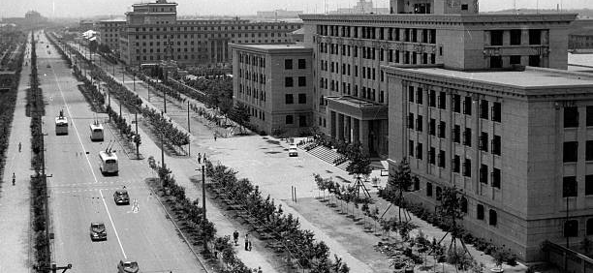
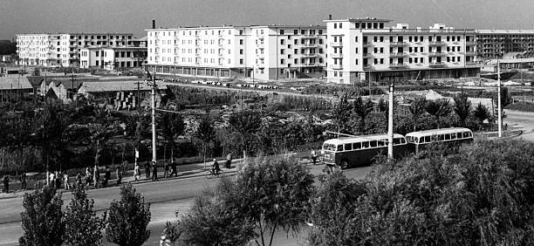
After the Great Leap Forward 1961-1965
Under Liu Shaoqi and Deng Xiaoping
Agricultural Production Bounces Back
Grain Output Up:
193,000,000 (1961) tons to 240,000,000 (1965)
Urban Industrial Production Bounces Back
Industrial Production Up:
11% Growth Rate (Annually)
7% Industrial Employment Growth (Annually)
Productivity Up 5.5 Percent Annually
Cities Grew Quickly, The Countryside Grew Slowly
Healthcare and Education Unevenly Distributed

Slide 19
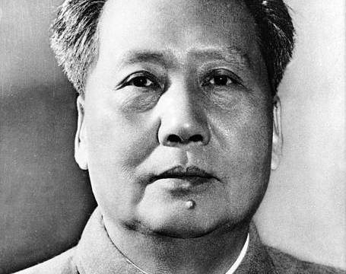
Mao Criticized (1962-1965)?
Angry Mao:
Mao believed he was “treated as a dead ancestor.”
Deng Xiaoping “never came to consult me.” “From 1959 to the present (1966) he has never consulted me over anything at all.”
Critics of Mao:
Wu Han’s Hai Rui Dismissed from Office
A Great Leap Forward play made with Mao’s approval to combat dishonest reporting of output figures. Hai Rui was an honest Ming official who lost his job after challenging a tyrannical emperor.
Jiang Qing and Yao Wenyuan argued the play was an attack on Mao.
Yao Wenyuan: The play misrepresented the history and contained messages that aimed to push people to demolish the people’s communes. “Anyone wanting to overthrow a political regime must create public opinion and do some preparatory ideological work.”

Slide 20
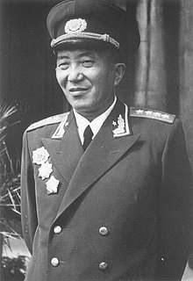
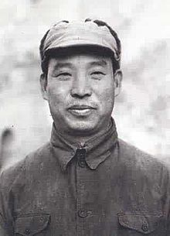
The Cultural Revolution (Phase I): The Political Phase
Begins in 1965-1966 with attacks on Wu Han
Academic to Political
Creation of the Central Cultural Revolution Group
Including Yao Wenyuan & Jiang Qing (Mao’s wife)
Early Purges (1966)
Liu Ruiqing
40 Years as a member of the CCP
Long military and security career
Crimes: Anti-party activity, suicide attempt
Peng Zhen
40 Years of service in CCP
Crime: Accused of being an associate of Wu Han
Politburo Standing Committee
Liu Shaoqi, Zhou Enlai, Zhu De, Deng Xiaoping (fail to intervene)

Slide 21
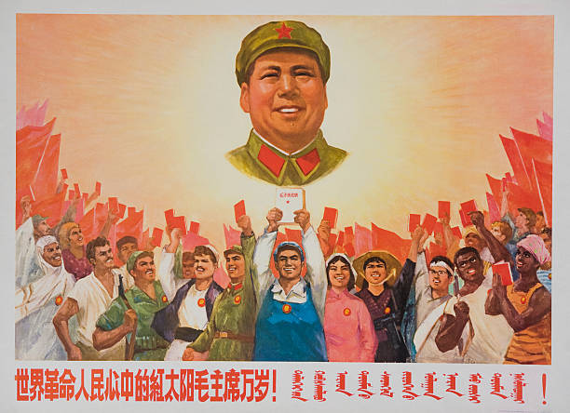
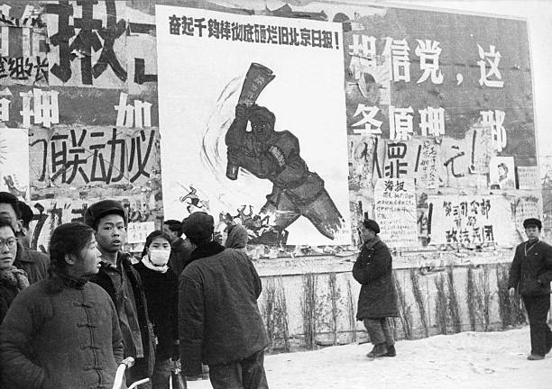
Cultural Revolution (Phase II): The Red Guard Phase
Cultural Revolution first spreads to the people through universities.
May 25, 1966: Nie Yuanzi posts first “big character poster” at Beijing University attacking the university president for suppressing student discussions of the Wu Han affair.
Poster reproduced throughout China
Liu Shaoqi & Deng attempts to “control” the movement with work teams.

Slide 22
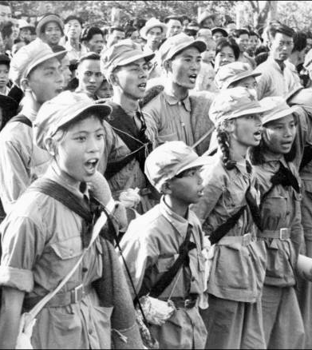
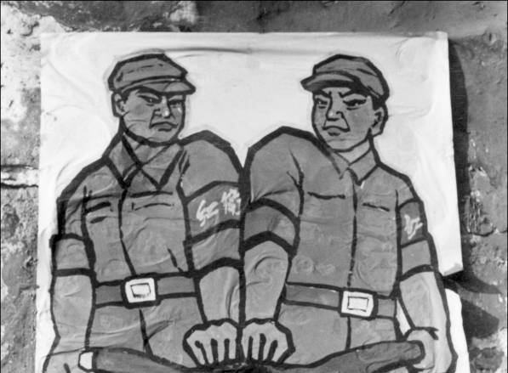
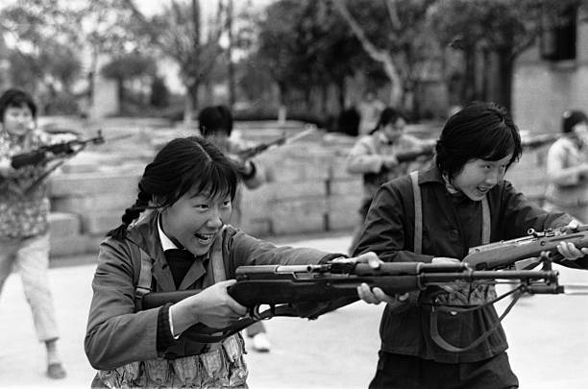
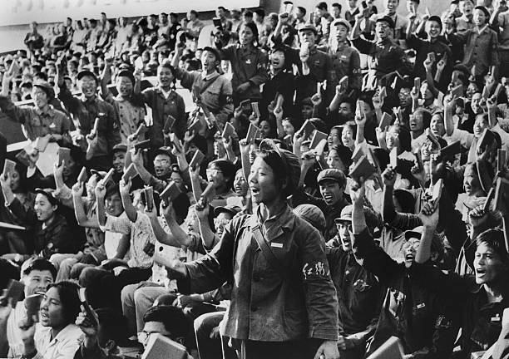
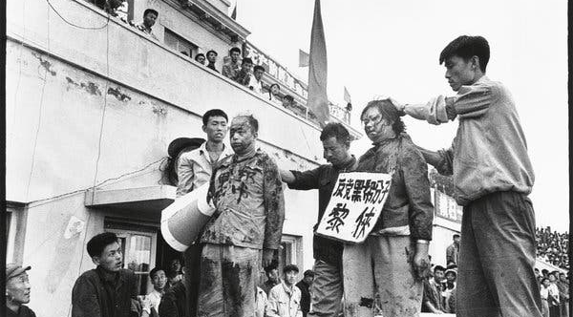
The Red Guard
Bombard the Headquarters (August 1966)
Mao pens letter in support of Red Guard.
But in the last fifty days or so some leading comrades from the central down to the local levels have acted in a diametrically opposite way. Adopting the reactionary stand of the bourgeoisie, they have enforced a bourgeois dictatorship and struck down the surging movement of the great cultural revolution of the proletariat…How poisonous! Viewed in connection with the Right deviation in 1962 and the wrong tendency of 1964 which was ‘Left’ in form but Right in essence, shouldn’t this make one wide awake?
Tens of Millions of Red Guards
“It is justified to Rebel” “destruction before construction”
Free Travel
Destroy the “Four Olds”
Old Ideas
Old Culture
Old habits
Old Customs

Slide 23
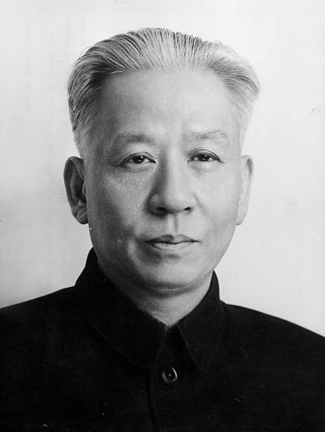
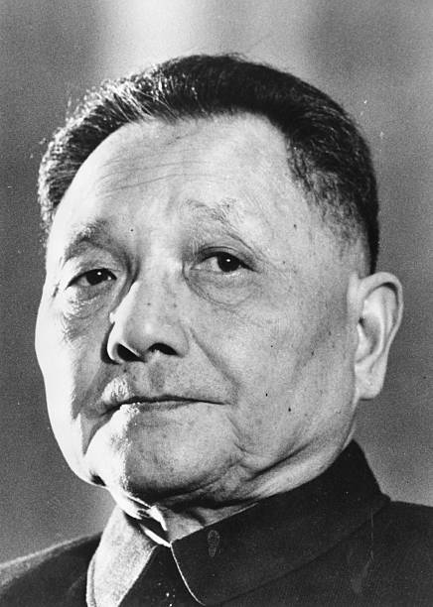
Eliminating Mao’s Rivals (1968-1969)
Mao’s & the Red Guard
Mao maintained loose political and ideological control
Used the Cultural Revolution to attack his rivals
Deng and Liu the most dangerous “capitalist roaders”
Deng Xiaoping deposed sent to work in a tire factory (1969)
Liu Shaoqi was accused of being an “enemy of the people.” He was subsequently denounced, imprisoned, beaten, denied medication. Dies in November of 1969.

Slide 24
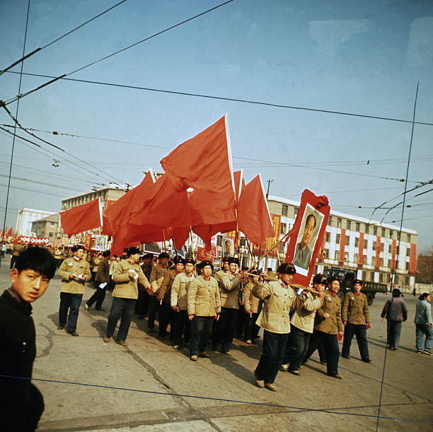
Fate of the Red Guard & Ultra-Leftist
1968 Red Guard suppressed by People’s Liberation Army.
At times involving military engagements
1968 Mao publishes order banishing the Red Guard youths from China’s cities. Between 1968 and 1980, 17,000,000 Red Guard are sent to live in the countryside.
Lost Generation
Many would not return until into the 1980s

Slide 25
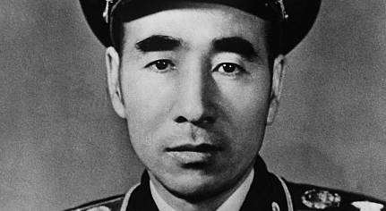
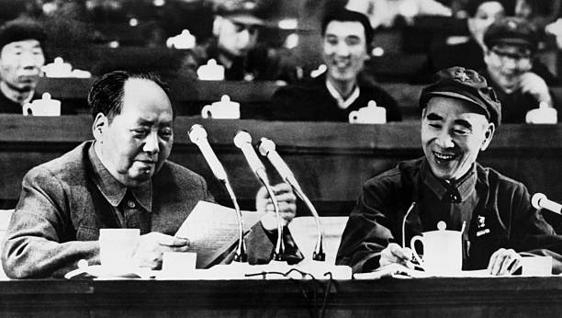
The Fall of Lin Biao
Lin Biao
One of Mao’s most trusted military leaders
Designated Mao’s successor
Key player in building Mao’s Cult of Personality within the People’s Liberation Army and the country more broadly
Rebuilding the Party
Mao shifts to rebuilding the Chinese Communist Party (1970)
Lin accused of “obstructing” the rebuild, “careerism,” and “conspiracy”
Lin’s Mysterious Death
Lin accused of attempting to assassinate Mao and launching a coup (July 28, 1972)
Killed along side wife and son when his plane crashed over Mongolia.

Slide 26
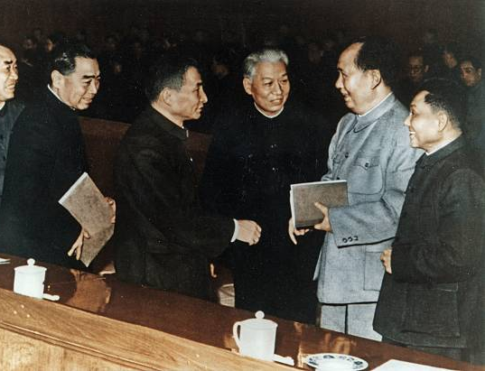
The Cultural Revolution through 1972
Mao’s weapon to “revive” the Chinese Revolution & Neutralize his rivals.
3,000,000 party and government officials lost their jobs.
500,000 people killed or committed suicide.

Slide 27
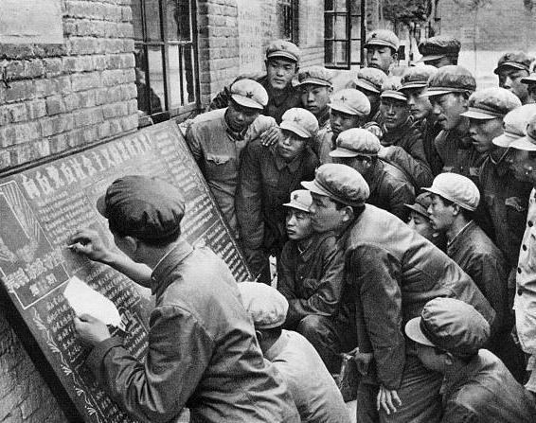
Question Review
What was the Cultural Revolution?
Who was responsible for the Cultural Revolution?
What were the origins of the Cultural Revolution?
What were the long-term consequences of the Cultural Revolution?
Module Questions
When did the Cultural Revolution begin, who launched it, and Why?
Why did so many Chinese citizens go along with the Cultural Revolution?

